Slide 1

LGBOOST REGRESSOR

Slide 2
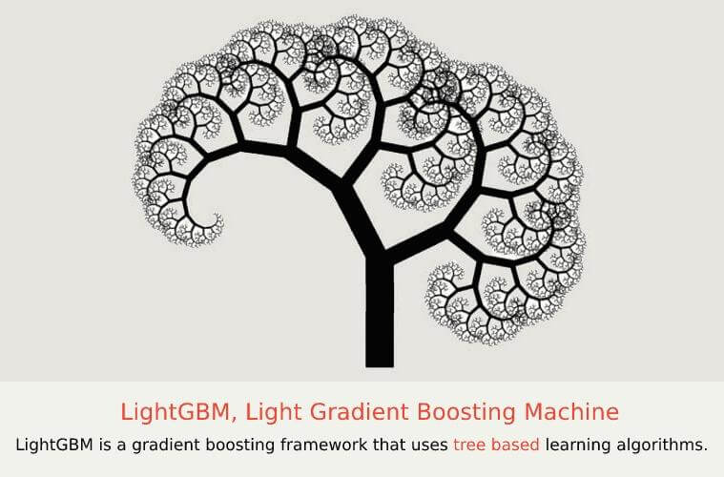
Light GBM is a fast, distributed, high-performance gradient boosting framework based on decision tree algorithm, used for ranking, classification and many other machine learning tasks

Slide 3
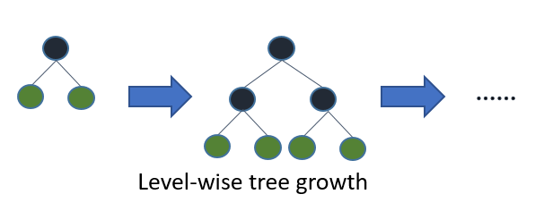
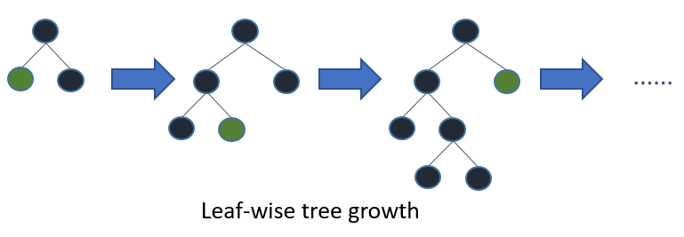
when growing on the same leaf in Light GBM, the leaf-wise algorithm can reduce more loss than the level-wise algorithm and hence results in much better accuracy which can rarely be achieved by any of the existing boosting algorithms.

Slide 4
The main features of the LGBM model are as follows :
Higher accuracy and a faster training speed.
Low memory utilization
Comparatively better accuracy than other boosting algorithms and handles overfitting much better while working with smaller datasets.
Parallel Learning support.
Compatible with both small and large datasets

Slide 5
Formulla:
“Y=Base_tree(X)-lr*Tree1(X)-lr*Tree2(X)-lr*Tree3(X)”

